Slide 1
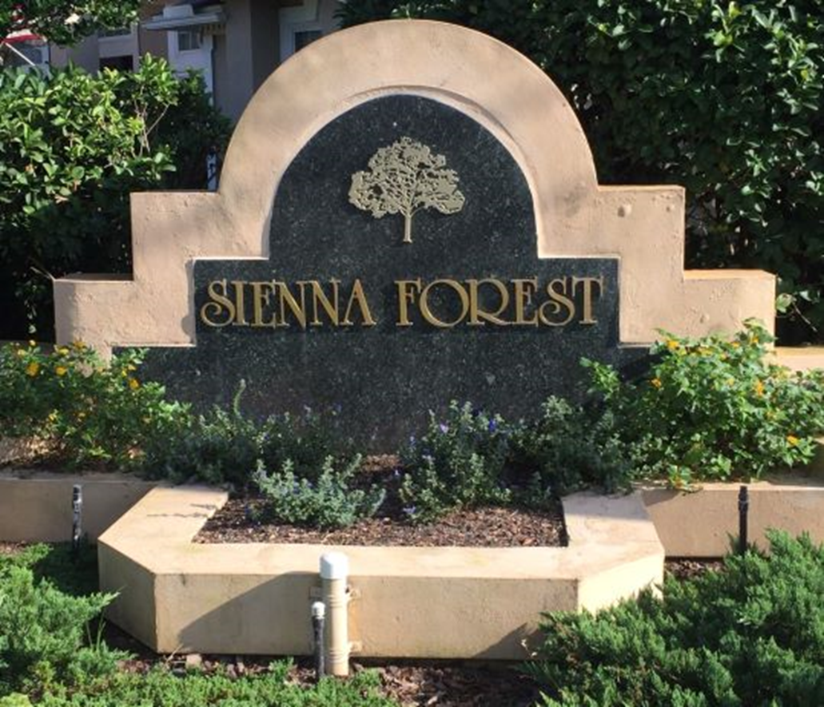
Sienna Forest Homeowners Association
4/11/22

Slide 2
Agenda
Welcome/Purpose of Meeting - Kurt
Covenants HOA Responsibilities
Covenants Homeowner Responsibilities
Swale Repair History
Current State Tanya Ter East
Assessment
$600 to be paid within 1 month
Or 1st $300 payment within 1 month and 2nd $300 payment within 2 months
Questions
Member Vote Assessment only - Cheryl
1 vote per lot

Slide 3
HOA Responsibilities
Maintain Stormwater Management System installed by the Developer
STRWMD Permit No. 42-03101431IM
Maintain Retention pond
Maintain Drainage
Contract with vendors
Articles of Incorporation 3e: “Maintenance. Too maintain, manage, repair, replace and operate all the common areas, including but no limited to the street right of ways and the stormwater management system and all associated facilities.
Covenants and Restrictions 5b: Stormwater Management System The Association [sic] provide and be responsible for the maintenance, operation and repair of the Stormwater Management System installed by Developer as part of the Work [sic]Matinenance of the stormwater Management System shall mean the exercise of practices which allow the system to provide drainage, water storage, conveyance or other surface water or stormwater management capability as permitted by the St. Johns River Water Management Disctirct

Slide 4
HOA Responsibilities
Covenants and Restrictions 5c: Notwithstanding any other provisions to the contrary herein or elsewhere, the Association’s responsibility to maintain at it sole expense the Stormwater Management System, may not be altered, mitigated, abated, terminated or otherwise lessened. This provision for maintenance shall inure to the benefit of governmental authorities having jurisdiction over said areas as well eeas the owner of any property abutting said areas, and the governmental authority or Owner shall have the right to enforce, by a proceeding at law or in equity, the provisions contained in this Declaration which relate to the maintenance, operation or repair of the Surfacewater Management System.

Slide 5
HOA Responsibilities
By Laws 5.1: General. The board has the power to exercise for an on behalf of this Association all powers, duties, and privileges vested in, or delegated to, this association and not reserved to its membership by any provision of these By-laws, the Articles, or the Declaration. Without limitation, the Board may employ all managers, independent contractors, professional advisors, and employees and agents as the Board deems advisable, prescribe their duties, and fix their compensation if any. The board has the authority to contract for services an materials to be provide for the benefits of the Owners or the Property consistent with the provisions of the Declaration.

Slide 6
Homeowner Responsibilities
Owners shall not construct any improvement on the easement areas, nor alter the flow of drainage, nor landscape such areas with hedges, trees or other landscape items that might interfere with the exercise of the easement rights.
Provide access to the HOA and its contractors to carry out its duties

Slide 7
Swale Repair - History
1/18/21 – Letter notifying residents of swale work
3/2/21 - Absolute Contracting contract signed ($10k)
6/21/21 – Swale Repair Begins
7/12/21 - Absolute Contracting Punchlist 1 work done
8/2/21 - Punchlist 2 submitted to Absolute Contracting
10/4/21 - Solid Rock Engineering Consulting
10/28/21 – Solid Rock Formal design provided ($50k est for pipe)
11/18/21– Earthworks consulting first site visit

Slide 8
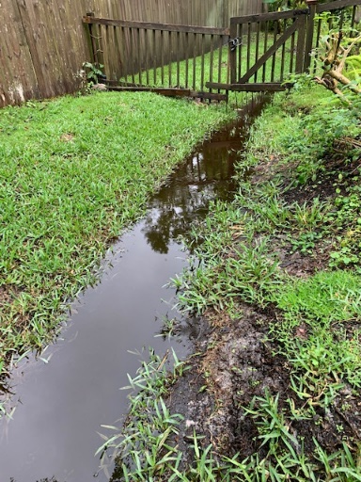
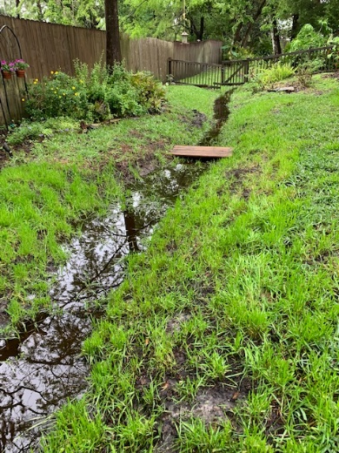
Current State of Tanya Terrace E
20 items on the punchlist from 8/2/21
Erosion
Standing Water
Dead sod

Slide 9
Vote Results - Cheryl
Proxies/notices mailed 3/22/22
Street Signage up 3/31/22
One vote per lot – Must be class a
Covenants and Restrictions Article 6.3 - 2/3 of member vote for special assessment
Complete ballot with street address and turn into Cheryl
Turn in proxy votes with vote to Cheryl
Count

Slide 10
Backup

Slide 11
Easements
10 feet parallel to front and back lot lines
5 feet along each side lot line
36-37 and 37-38 have 12.5 foot easements on side lot lines
Easement over all portions of a lot (except where unit is constructed) to maintain, correct, and improve drainage of surface water. Including the right to cut trees bushes, shrubbery or make gradings
Restore surface to its original condition as practical, but not required to replace or repair fences, walls, structures, landscaping or other improvements that were located within the easement areas

Slide 12
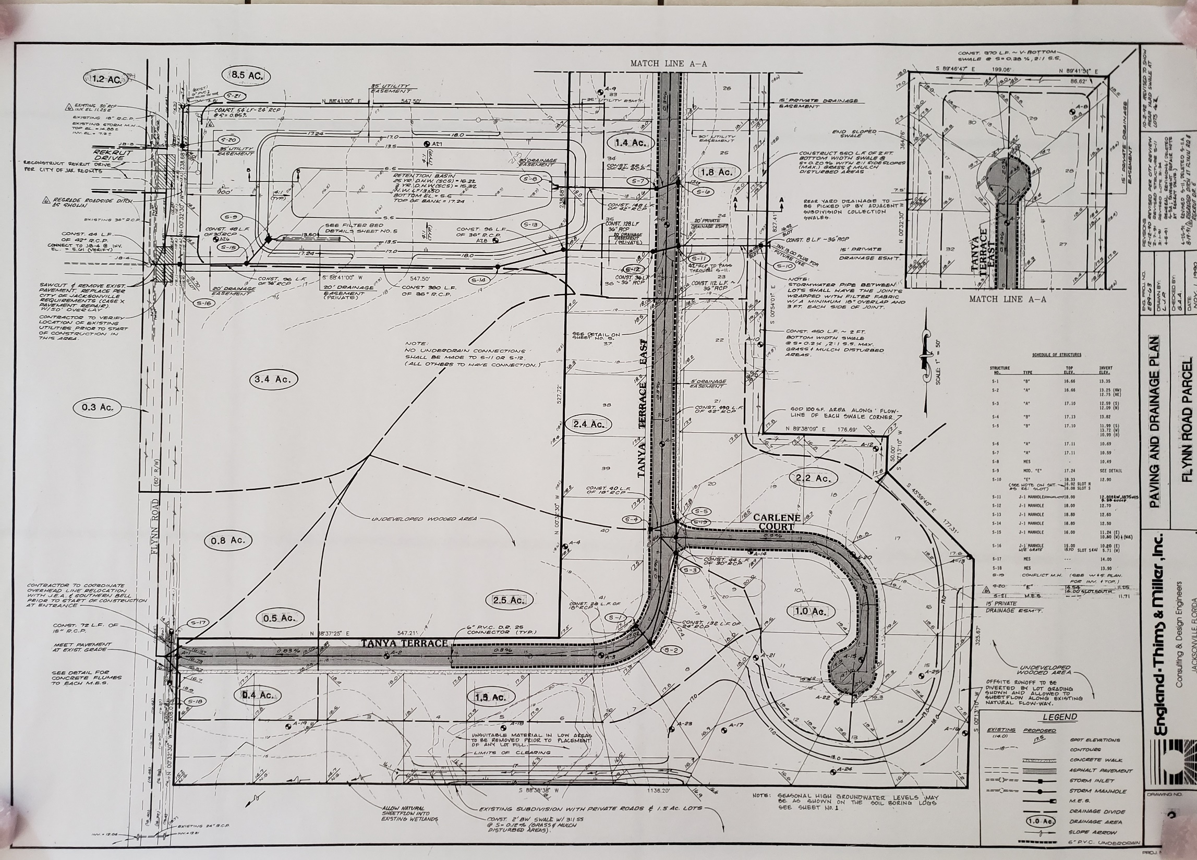

Slide 13
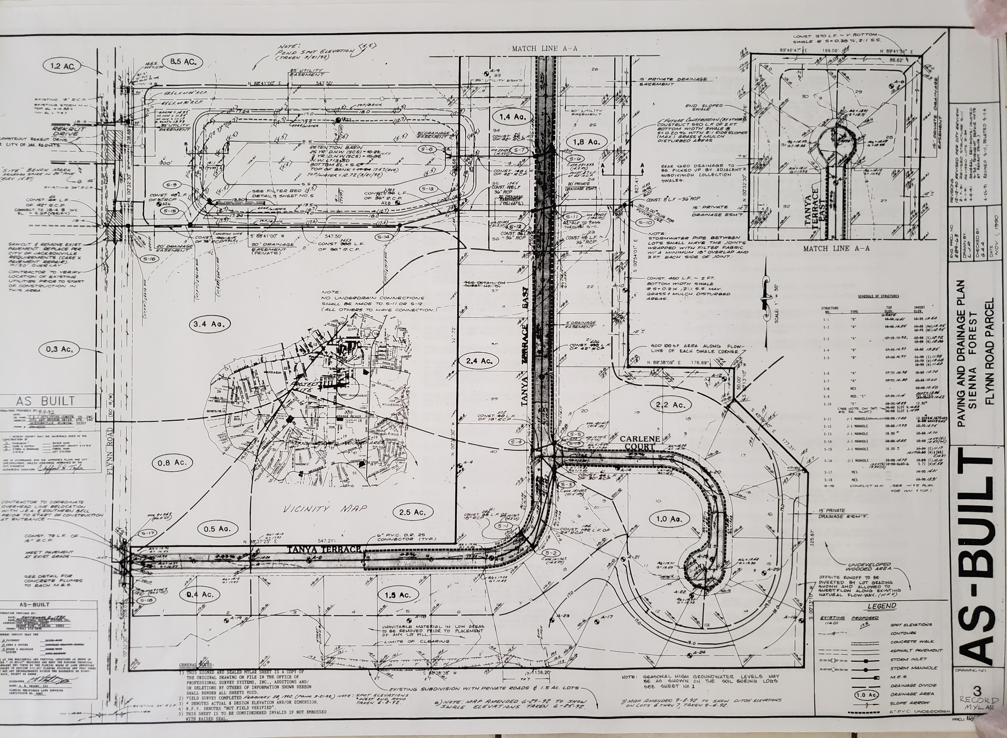

Slide 14
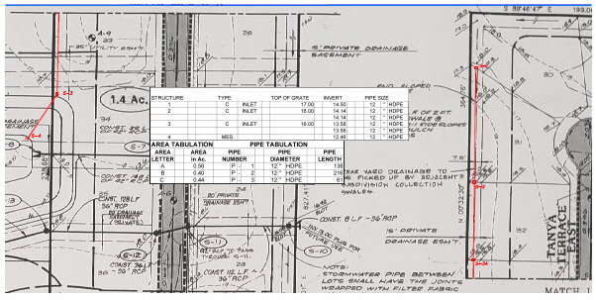
Solid Rock Engineering Swale Plan

